Slide 1
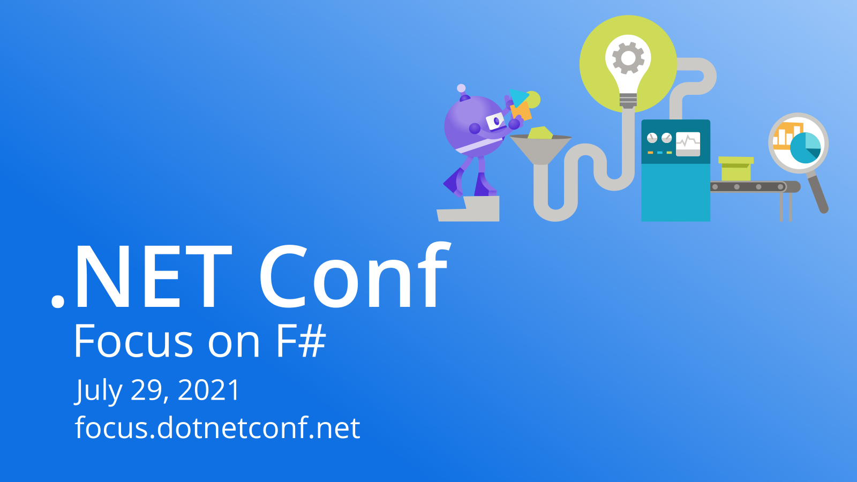

Slide 2

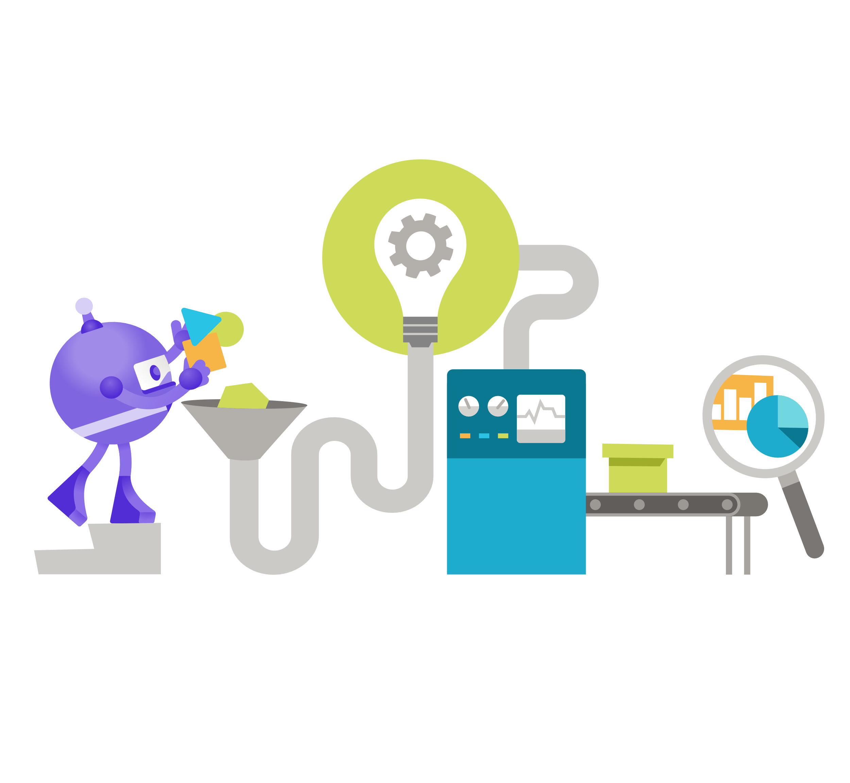
F# Bonanza!
Don Syme & F# Community Contributors
@dsymetweets

Slide 3
Three Big Themes Today
Succinct
Robust
Performant
Notes:
2 minutes

Slide 4
What is F# good at?
dot.net/fsharp

Slide 5
F# is good for programming
dot.net/fsharp

Slide 6
F# is good for web programming
dot.net/fsharp

Slide 7
F# is good for cloud programming
dot.net/fsharp

Slide 8
F# is good for AI/ML/data-science programming
dot.net/fsharp

Slide 9
F# is good for succinct programming
dot.net/fsharp

Slide 10
F# is good for correct programming
dot.net/fsharp

Slide 11
F# is good for performant programming
dot.net/fsharp

Slide 12
F# is good for programming
dot.net/fsharp

Slide 13
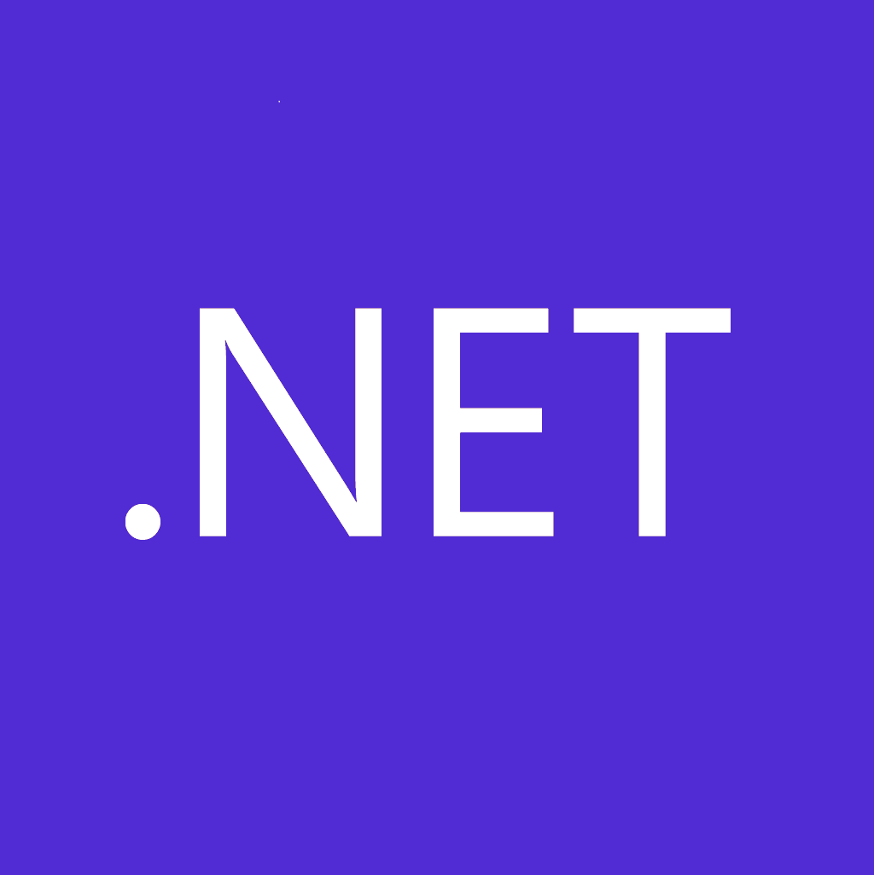
F# get started
dotnet new -lang F# dotnet build
F# tools are part of the .NET SDK, available everywhere
www.dot.net

Slide 14

F# for the web backend
dotnet new -i "giraffe-template::*" dotnet giraffe
High perf, functional server-side programming
A functional ASP.NET Core micro web framework for building rich web applications. github.com/giraffe-fsharp/Giraffe

Slide 15

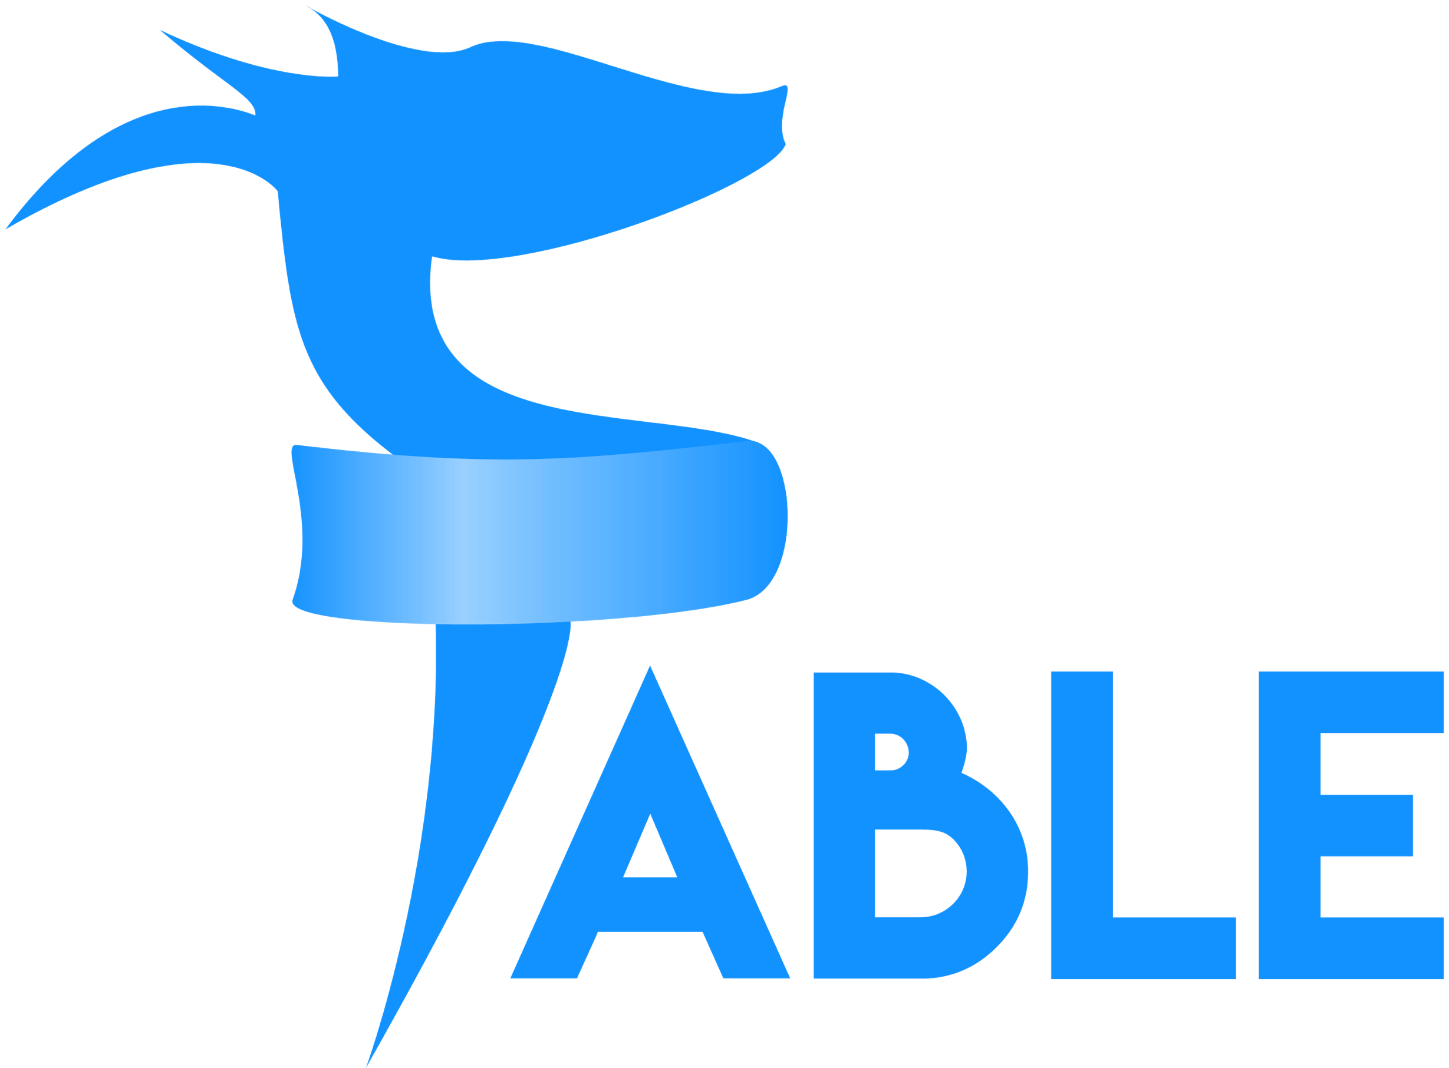
F# for the web frontend (JavaScript)
dotnet new -i "Fable.Template::*" dotnet new fable npm install npm start
You can use F# as a JavaScript language
websharper.com
fable.io
Notes:
WebSharper also includes an excellent JavaScript compiler for F#

Slide 16
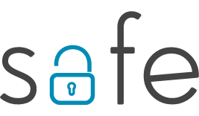

F# for the full stack with SAFE
dotnet new -i SAFE.Template dotnet new SAFE dotnet tool restore dotnet run
=
+
+
Notes:
NOTE: other excellent full-stack options exist, including “WebSharper”

Slide 17
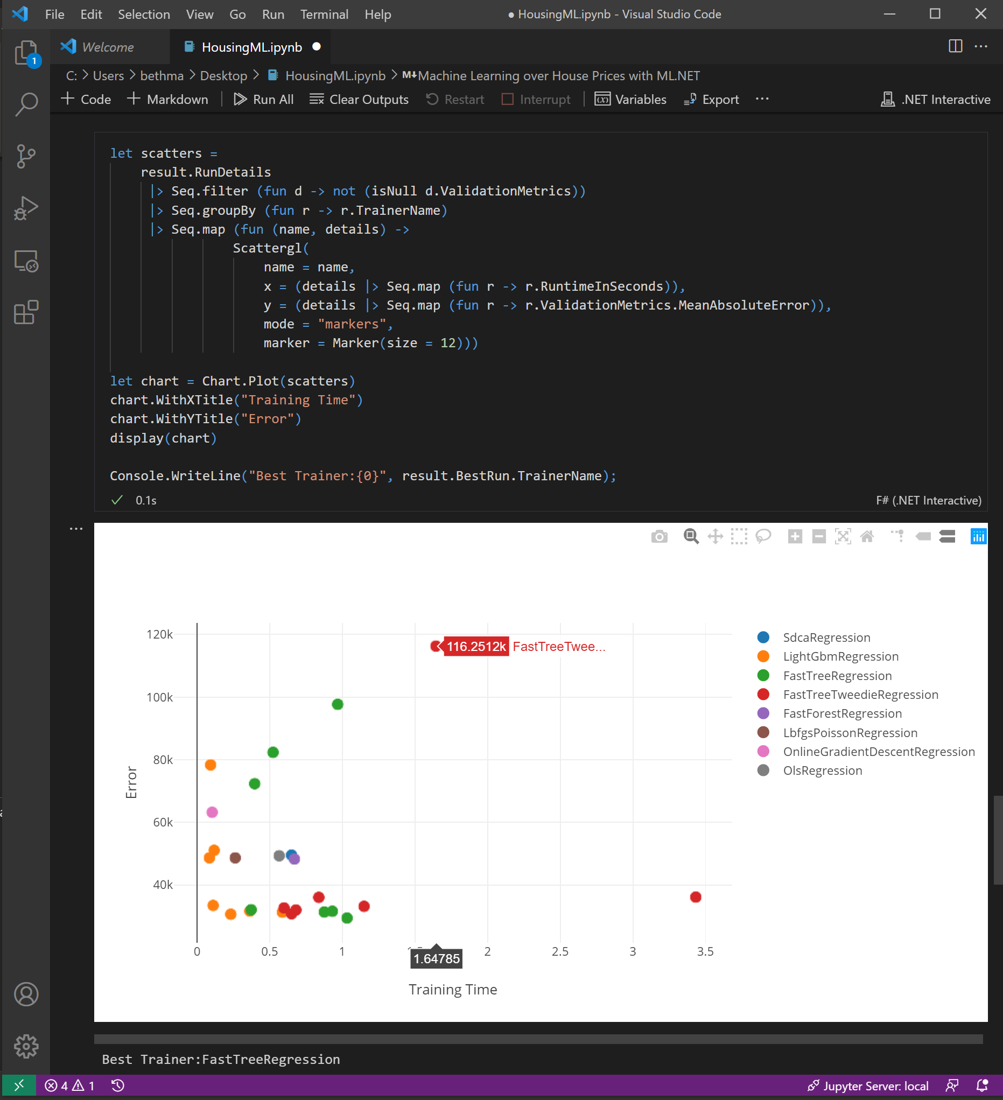
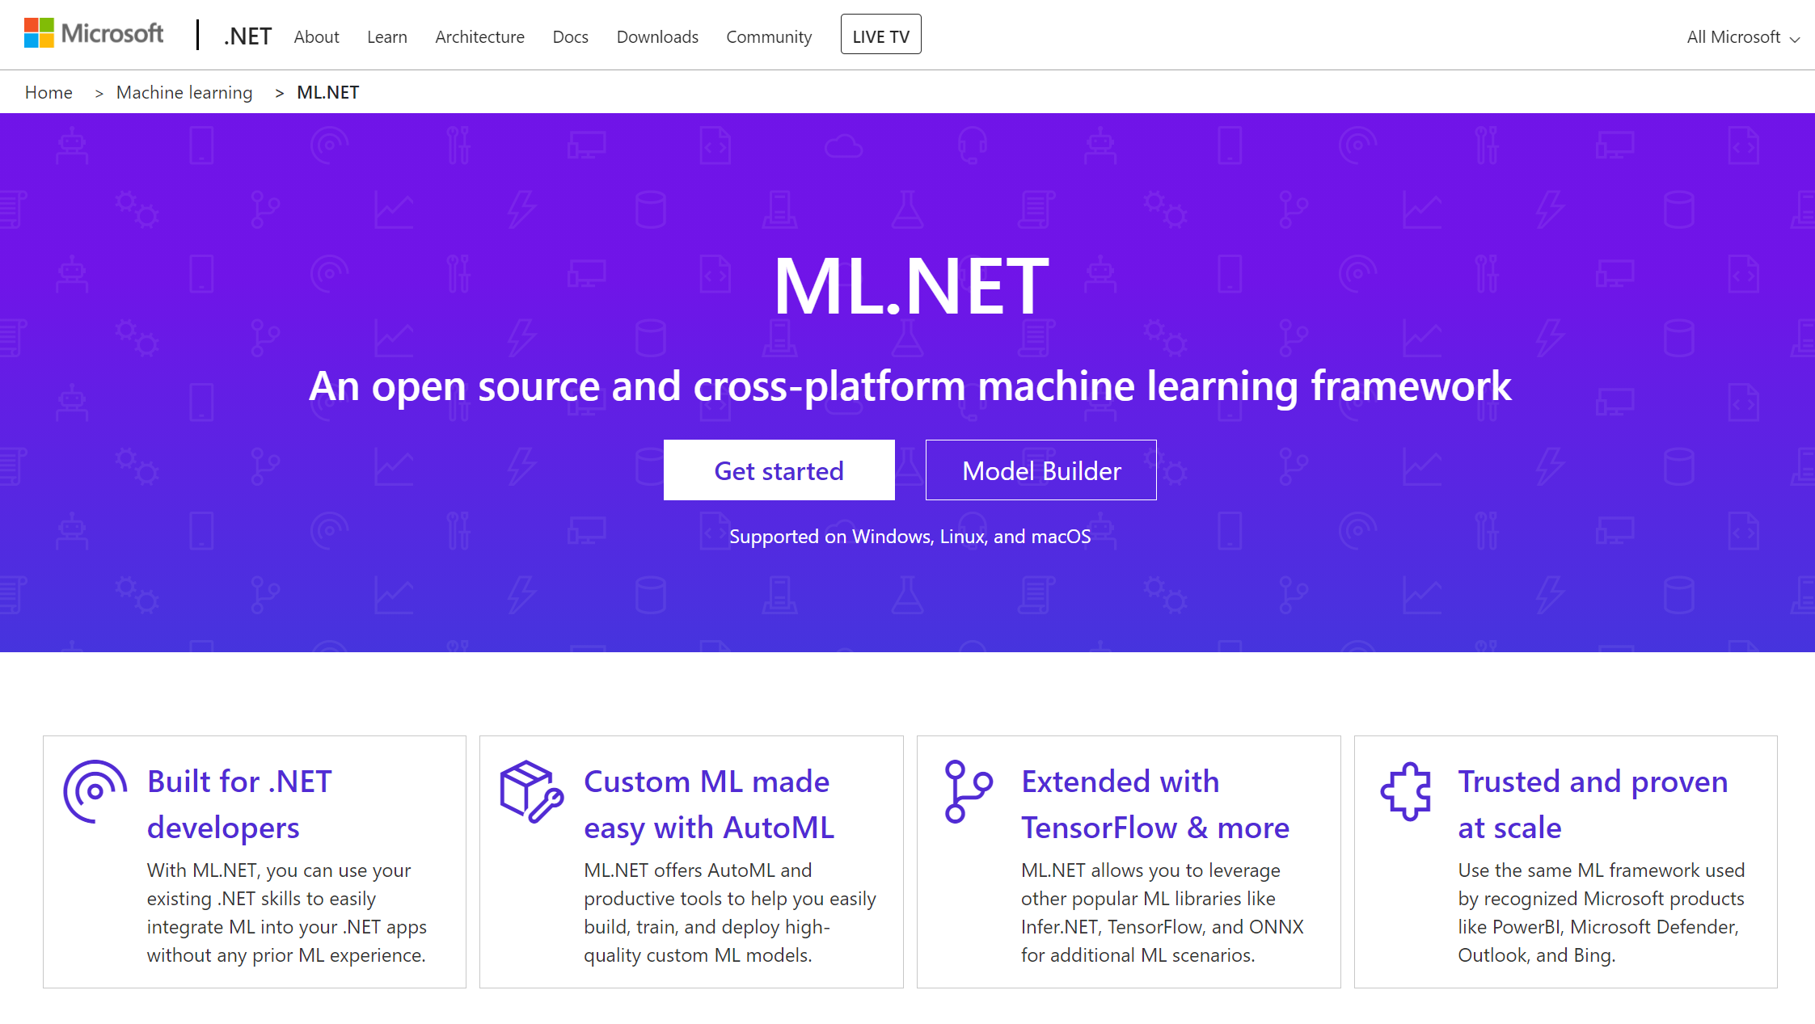
F# for data science & ML
#r "nuget:Microsoft.ML,1.4.0"
#r "nuget:Microsoft.ML.AutoML,0.16.0"
github.com/dotnet/interactive
dot.net/ml

Slide 18
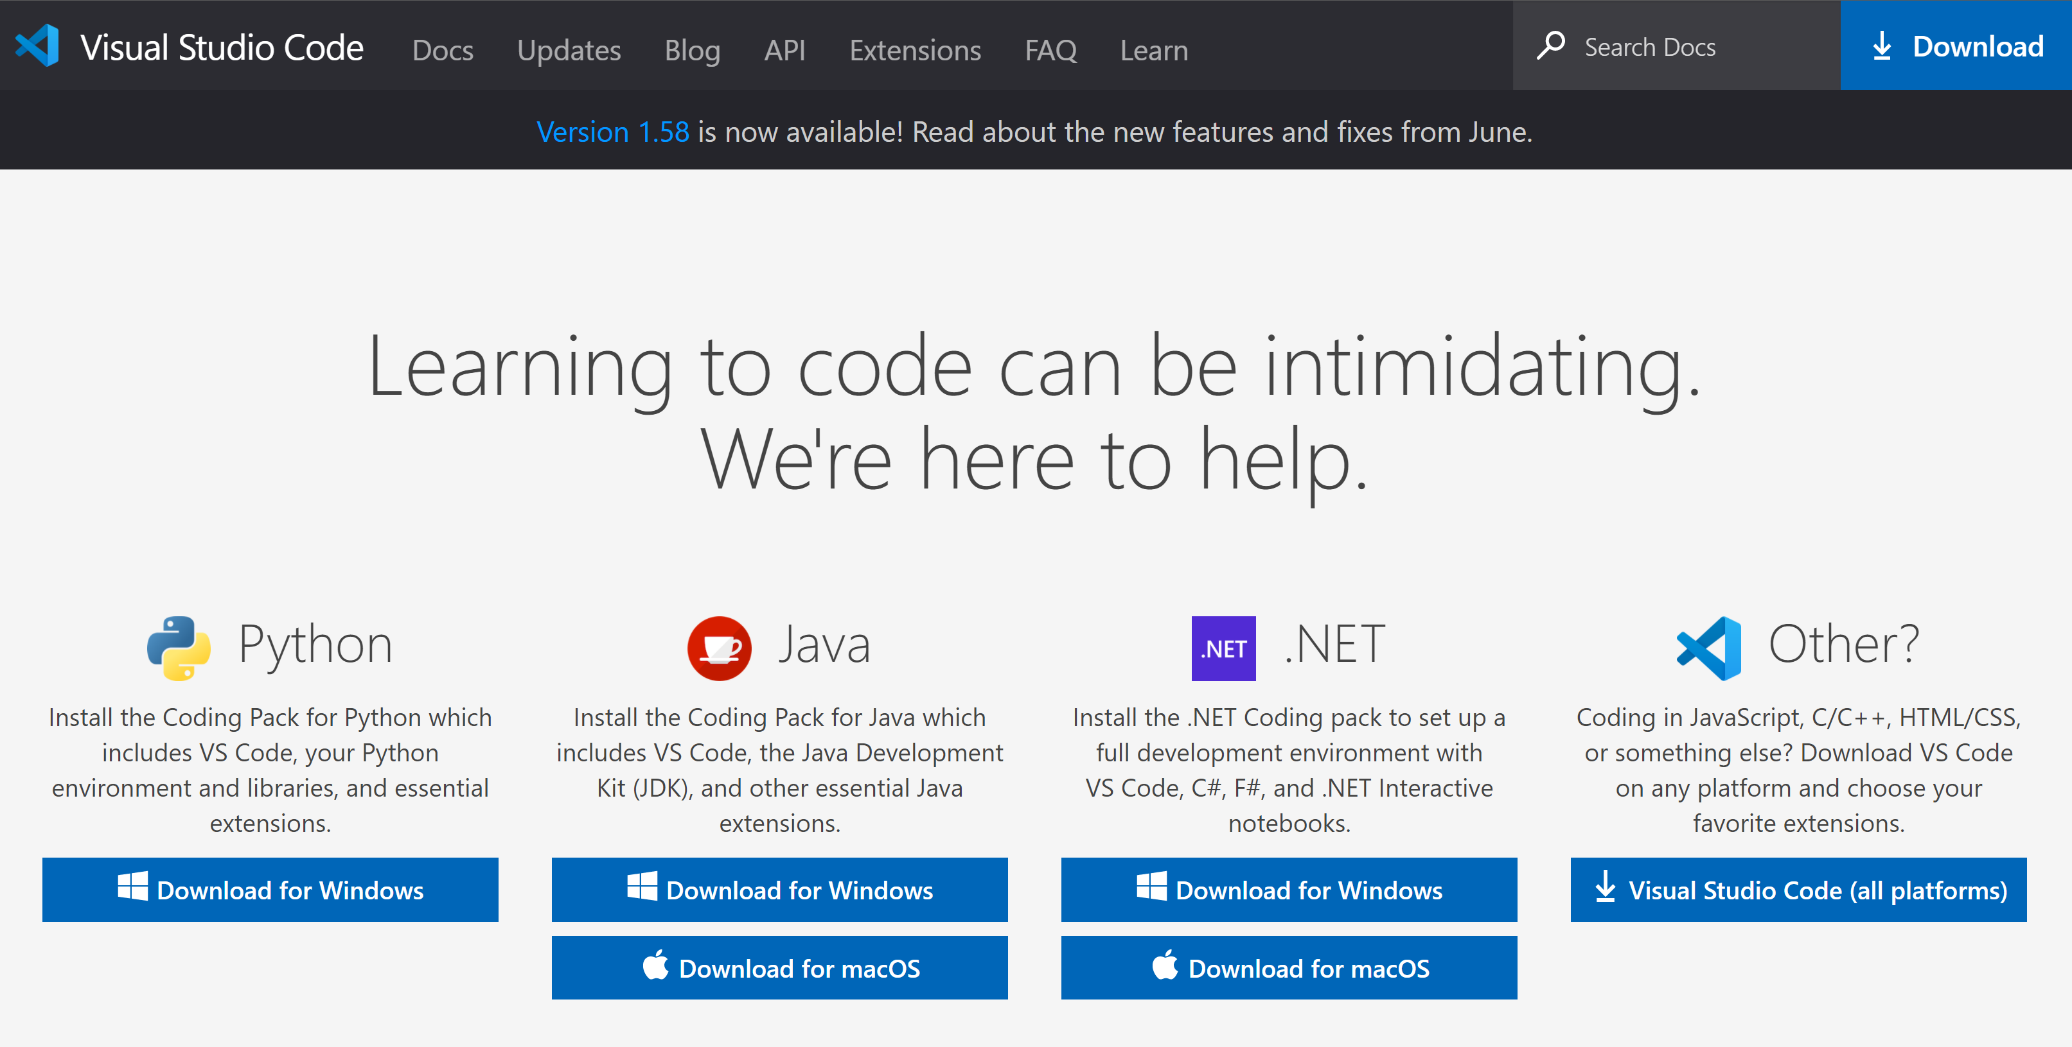
code.visualstudio.com/learntocode

Slide 19

F# for a better world
Notes:
Cue – for Jeff.
TIME CHECK: 7 min

Slide 20
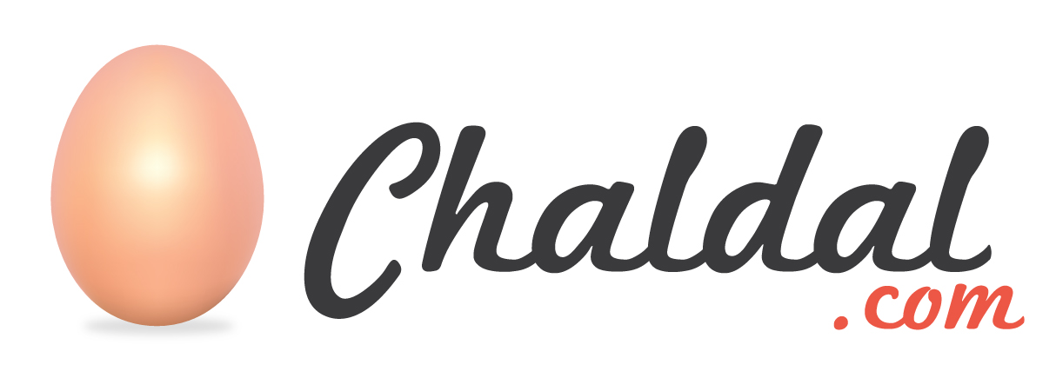
Tejas Vishwanath Co-founder & CTO, Chaldal
Supporting Supply Chains, Farmers and Refugee Camps with F#
Notes:
Intros Don & Guest & Slide – 1 minute (Tejas can intro himself)
Hi Tejas, it’s an honour to have you join today…. Chaldal is the largest e-commerce company in Bangladesh….
This is personal for me, having visited Bangladesh in 1994. The country has come a long way.
Could you tell us a little about how Chaldal got started, and the kind of work you’ve been doing, both commercial and non-commercial?
Could you tell us a bit about why you chose F# to build out your technology stack, and what sort of advantages it’s been giving you?
What have your biggest challenges been along the way?
Chaldal is the largest e-commerce company in Bangladesh, a country of 150M people, serving some of the world's most densely populated cities. We started off in the capital city, Dhaka, with grocery delivery, and we were the first in the world to offer 1-hour delivery, operating out a network of micro-warehouses. As we scaled up, we had to build technology into the supply chain, all the way back to the farms. Since 2019, we have been working with the UN World Food Programme to supply nutrition to the Rohingya refugee camp, and with various government development agencies (local and international) to structure Bangladesh's perishable supply chain and create a mobile-app powered wholesale markets for road-side retailers.
Due to the lack of a tech ecosystem in Bangladesh when we started off, we've had to build out large parts of the technology stack that we take for granted in the developed world such as mapping, logistics, payments, HR systems and data centers. We also needed to own our inventory, warehouses and delivery vehicles and employ workers full-time to ensure reliable service. This made our business very capital intensive, and unfortunately access to capital in developing countries is very limited, which also meant in our early days we couldn't run a large engineering team.
We needed a technological edge to keep up with our peers in other markets, and for us, that was F#. When we need to launch a new system, such as an online pharmacy, this is what we do:
We start by visualizing the many components of this system as a set of interdependent finite state machines (we call these subjects). These subjects are modelled using F#'s powerful type system in such a way that most illegal states are unrepresentable, thereby preventing a large class of bugs.
We then use a DSL (computation expressions) to specify the state transitions of these subjects based on actions, and their interaction with other subjects. We also have DSL to simulate these interactions in a test environment.
A user interface, powered by Fable, is scaffolded that provides a reactive canvas connected to backend systems which renders the UX. Since Fable is based on F#, our domain models are shared between the UI and the servers. The framework is built on top of ReactXP (React Native + React Web), so using a single F# codebase, we're able to churn out cross-platform mobile apps and web apps.
Finally, since our backend is fully typed and structured, we're able to generate a Django-like admin panel, to help our operations team perform various back-office tasks on subjects (such as verifying orders) without any added UI. Here, we're able to leverage F#'s quotations to analyze the state transition functions and prune out dead code paths, given the current state of a subject, so the UI that is generated is simpler and intuitive.
There have been some challenges along the way, the biggest one being persistence. Our F#-based domain model is so rich that it becomes very tedious to convert all that richness back-and-forth to SQL for RDBMS. So here, Gus (F#+) devised a system of "codecs" that will serialize and persist these models, and a DSL to evolve them as the types and business requirements change. We will soon open-source these libraries to give back to the F# community.
Overall, our team's reception to F# has been very positive; most people who join us do not know F#, but pick it up quickly within the first two months, and once they do, it becomes a very enjoyable experience to design large systems the F# way.
===========
I, Tejas Viswanth, Director, CTO at Chaldal Inc, hereby grant you permission to use the above information, the name of the company and its logo in any way you see fit.
Thanks!
Tejas

Slide 21
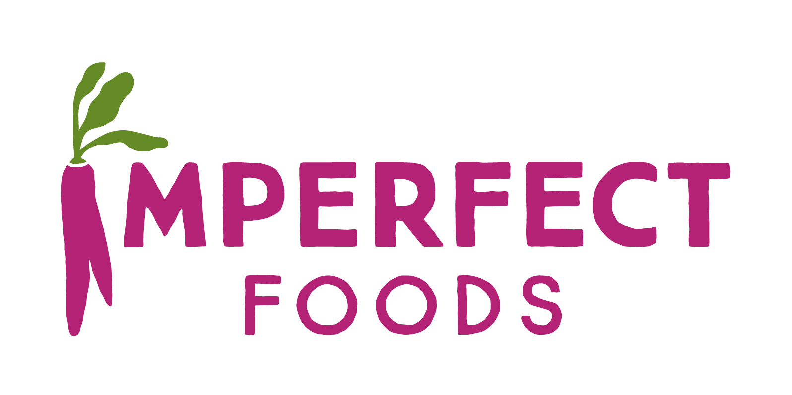
Kelsey Tripp Director Engineering, Imperfect Foods
Reimagining grocery delivery for a kinder, less wasteful world
Notes:
Intros Don & Guest & Slide – 1 minute (Kelsey can intro herself)
At Imperfect Foods, the software engineering team builds the ecommerce platform and internal supply chain and logistics tooling that supports their mission to eliminate food waste and build a better food system for everyone. Imperfect uses F# as their language of choice for backend services within a microservices architecture.
They value F# for its expressiveness and safety, and we are pragmatic practitioners of functional programming with an appreciation for the broader .NET platform!
Hello Kelsey, welcome to .NET Conf etc.
Tell us a little about Imperfect Foods , what it is and what your overall mission is?
So I understand you use F# in microservices. Could you explain a bit about what that means in practice?
You talk about being “pragmatic practitioners of functional programming” – why do you see F# as a natural choice for this kind of work?
Then more free-form discussion up to time allowed in conjunction with Tejas.

Slide 22
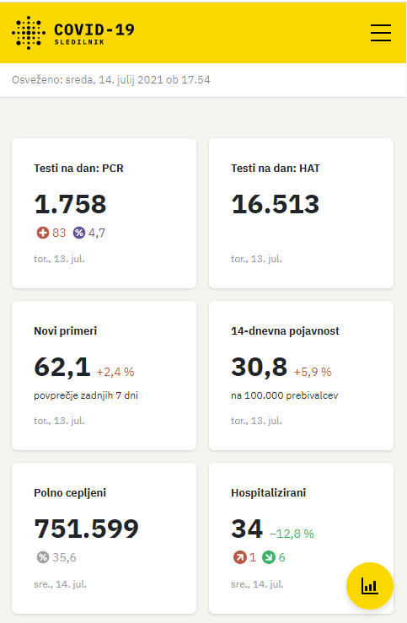
Built with F# Covid-19 Tracker Slovenia
Notes:
TIME CHECK: 18 min
Covid-19 Tracker Slovenia is a community run project that collects, curates and publishes the Covid-19 data for Slovenia. It came to life in march 2020 and serves around 1/2 to 1 million daily users.
This is an open source project with the source code available at https://github.com/sledilnik/website. It is a bit of an chimera in terms of the design components which reflects the it's coming-to-life process; at the start of the pandemic there was a need to come up quickly with something working so different people brought different technologies which are roughly this: Python for the data capturing/curation, C# for the data APIs, Vue as a SPA framework and finally, F#/Fable for the data wrangling and visualization on the frontend
The F# code is nothing spectacular or something one can be particularly proud of. However, and I find this interesting, it proved to be a good solution for an extremely quickly moving, decentralized project. Majority of the people contributing the code never used a functional programming language or even heard of the F# before, yet most of them were able to quickly find their way in the code and develop their own visualizations with little or no orientation and with very few bugs or runtime problems.

Slide 23

Built with F# Electric Car Charging Stations
Notes:
Our platform is operating 2300 charging points for electric vehicles in northern germany. The platform allows drivers to start and stop charging transactions and to pay with SMS/Carrier Billing, PayPal or credit card. We are live for almost exactly 1 year and we were able to triple our monthly sales in that first year. The market is growing like a Covid wave.
The platform is 100% F# on Microsoft Azure. It uses ASP.NET Core 5, Azure Functions, EventHubs, Azure Cognitive Search, Azure Storage and all that stuff. Frontend is Fable + Elmish with React. Basically it’s a big distributed SAFE Stack application.
Turns out F# ecosytem is surprisingly mature now. ;-)

Slide 24

Leading and growing F# teams

Slide 25
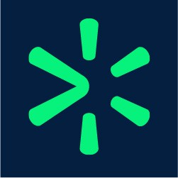
Eduard Ostrovsky Associate Director Engineering, Walmart Global Tech
Leading an Enterprise Team Using F#
Notes:
TIME CHECK: 20 min
Intros Don & Guest & Slide – 1 minute (Ed can intro himself)
“Hello Eduard, thanks for joining us here today, it’s great to have you along. I understand you’ve recently been growing a team at Walmart who use F# ? Can you tell us about the team you lead - what size are you, how do you fit in the Walmart business?”
<answer>
“Thanks, that sounds fascinating, and an important part of the business. What sort of programming is involved in order fulfilment – server-side, client side? Database?”
“What are your main concerns as a dev manager? Code quality? Code reviews? Careers? Ensuring recoverability? Logging? “
“F# code can be succinct, and clear. What practices do you adopt as a team for making sure this is the case?”
“How have you found it hiring F# developers? What are the typical backgrounds – did they learn F# on the job or did they already know it?”
*** “What resources and practices to you use in training and developing your team?” ***

Slide 26

Vagif Abilov Senior Consultant, Miles AS
Full Stack in Cloud & Media with F#
Notes:
Intros Don & Guest & Slide – 1 minute (Vagif can intro himself)
Tell us about NRK and the kinds of programming that underlie a modern major TV/media company
Tell us about how F# has played a role at NRK a the kinds of team settings you’ve been using it in
Tell us abut the profile of typical programmers using F# at NRK – how long do they take to get up to speed, do they find it easy to learn

Slide 27
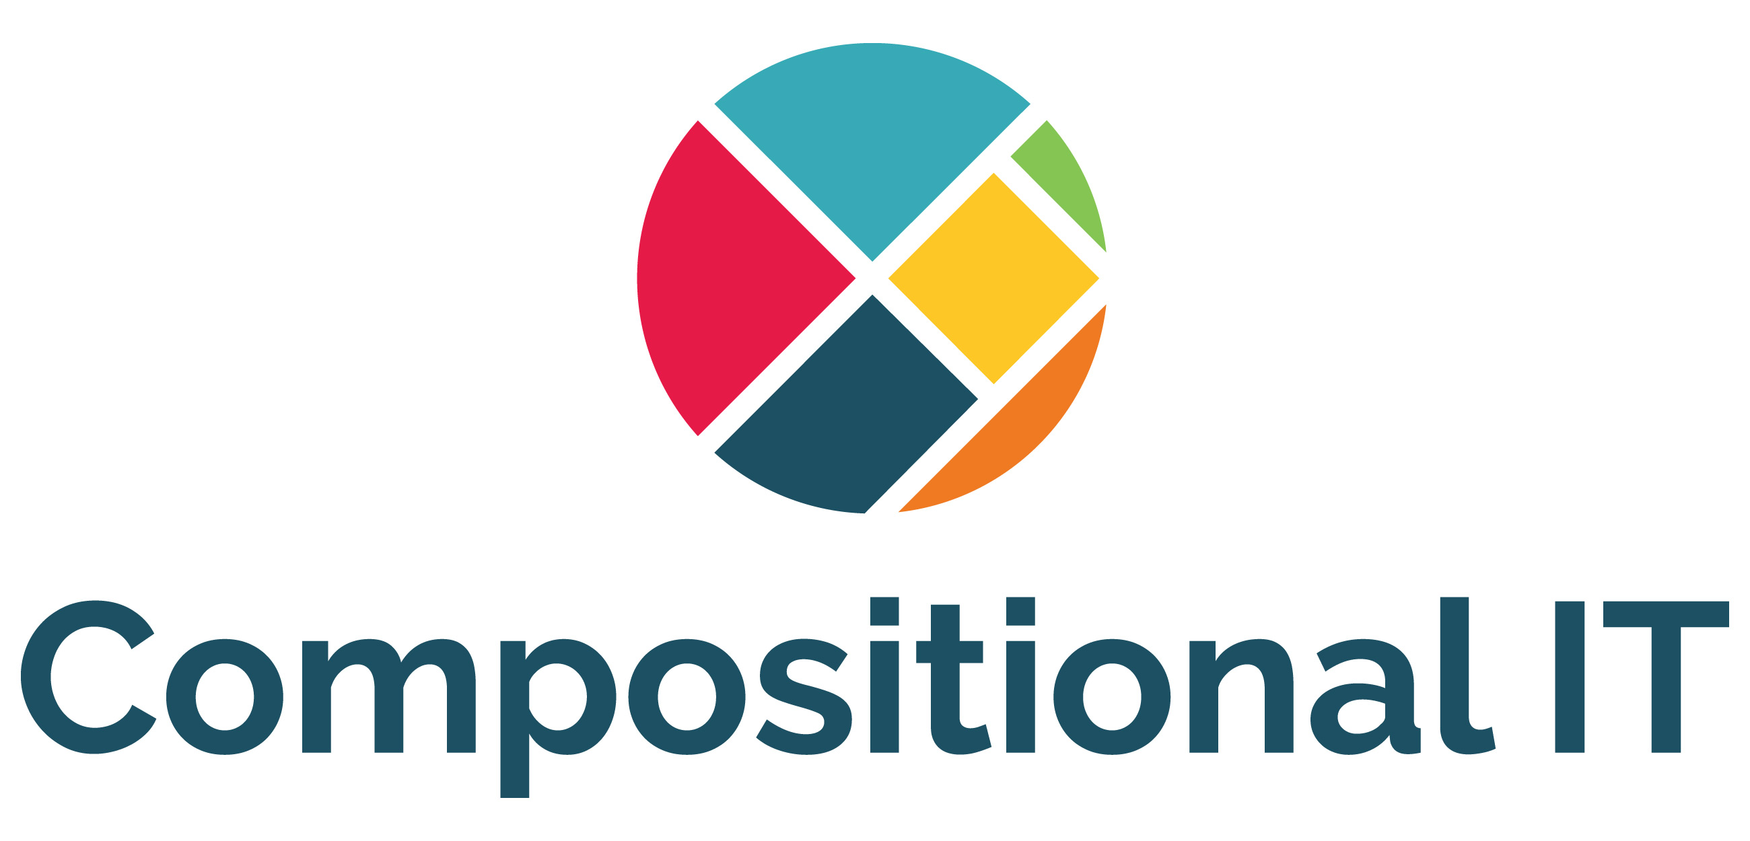
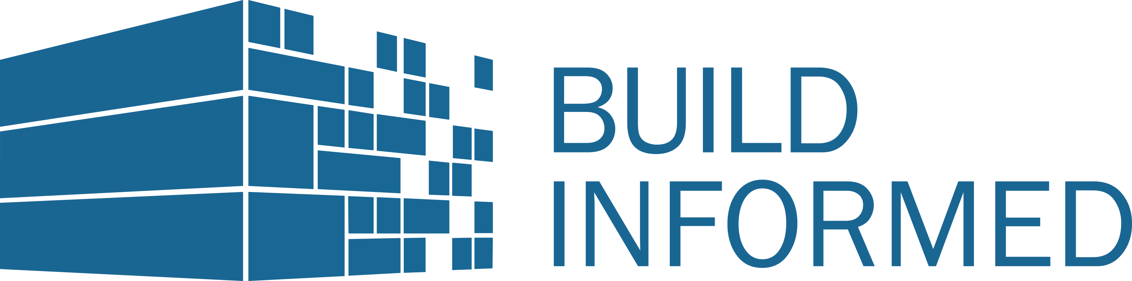
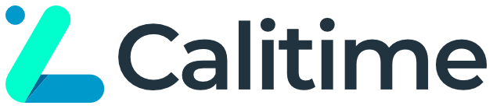

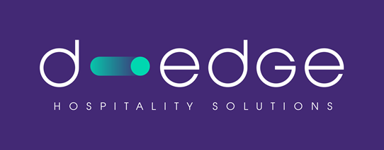
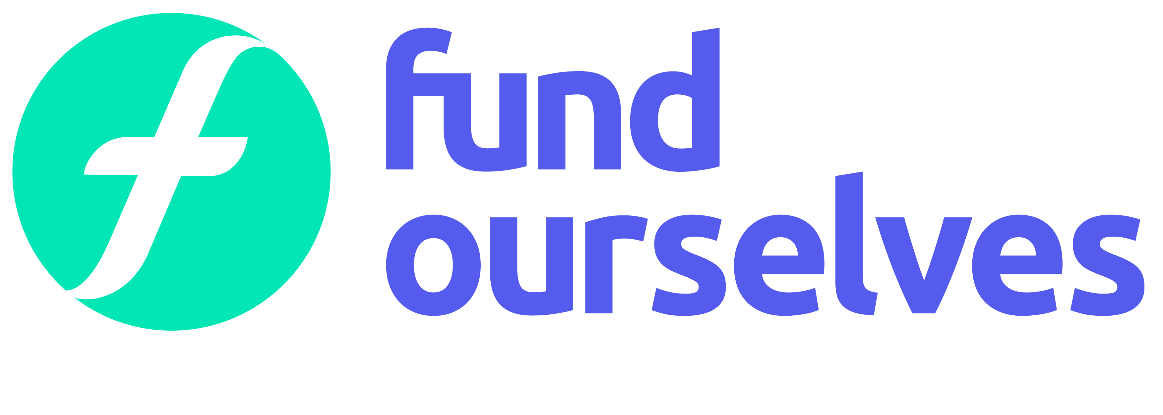

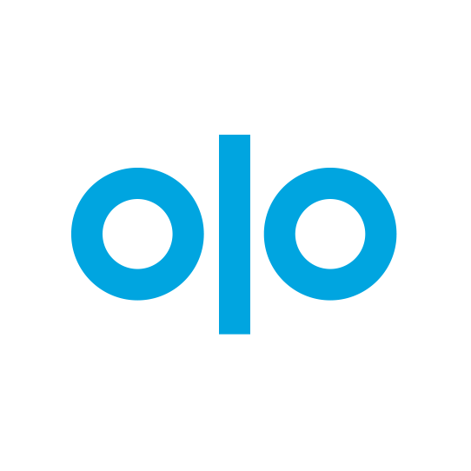
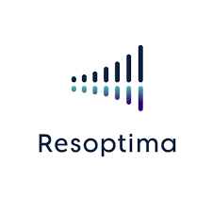
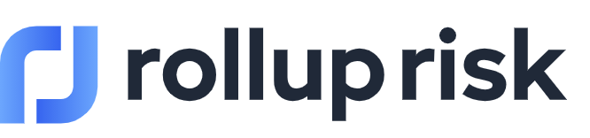




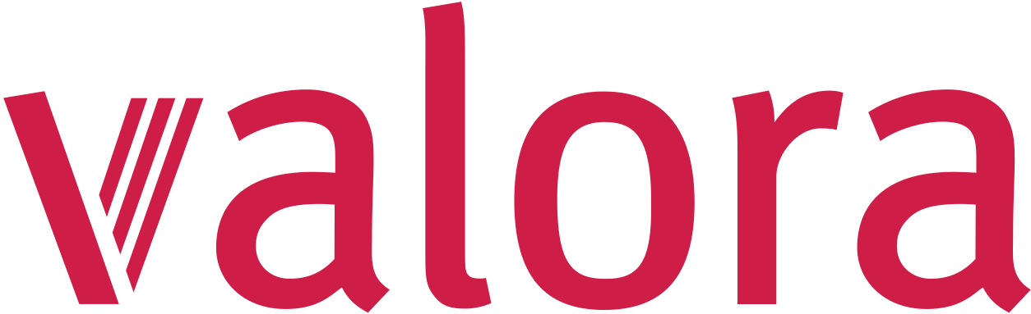

Notes:
TIME CHECK: 37 min
Here’s just a few of the many businesses using F# to build their software solutions. A lot of them are attending the conference today and are hiring F# developers. Call Let me call out a few here:
SoftwarePark chose F# because it allows them to codify domain logic clearly and concisely, deliver features quickly with very few bugs, and provide access to the excellent .NET ecosystem. F# is perfect for the data-intensive applications that they build; The GPS aggregation product they started building 18 months ago is already processing nearly 8 million signals for 60,000 devices across Europe every day. Promoting their use of F# has significantly increased the number of quality candidates actively seeking to work with them.
Rocket Mortgage is the nation’s largest home mortgage lender. They use F# to create microservices on .NET that come together as an event streaming platform to pool loans to sell on the secondary mortgage market. F#’s immutability by default characteristic intertwined well to the event-sourced system they designed. Today, they process tens of millions of events every day across dozens of services with a minimal infrastructure footprint, with F# being an important driver in that.
Calitime built a service for attendance time tracking and absence and shift-planning called TimeRocket. The system runs on Azure, and they use F# on the ASP.NET backend and Azure Functions to program the business logic. They like F# because discriminated unions, pattern matching, computation expressions and out-of-the-box equality allows them to keep the code simple even in complicated business cases.
CN Group provides IT Software Development and Consulting services. Five years ago they established a dedicated F# team that successfully delivers customer solutions using various functional programming techniques, technologies and libraries like Azure Functions, Giraffe, or full-stack with Fable & SAFE Stack. Applying a functional-first approach to customer projects in .NET led to better software quality, lower bug-ratio, shorter time-to-market, and what's most important - higher customer satisfaction.
OLO: Olo provides world class software-as-a-servicers for online orders and delivery for the restaurant industry. F# allows their engineers to write concise, expressive, and correct code to enable them to deliver solutions to their customers with confidence. Their engineers love working with F# and it has been a real asset in attracting high quality engineers.

Slide 28

“Succinct Like Python, robust and performant like C#, Scala, and Java”
Notes:
TIME CHECK: 40min

Slide 29
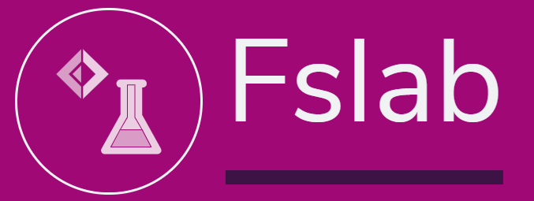
Kevin Schneider Researcher, TU Kaiserslautern
Using F# for Maths and Stats
Notes:
Faster intros. Don & Guest & Slide (20 seconds max each)

Slide 30

Ambika Eshwar Functional Programming Enthusiast, Rutgers
Getting Started with F#
Notes:
Faster intros. Don & Guest & Slide (20 seconds max each)
Hi Ambika, you’re a student at . Tell us how you first got interested in programming

Slide 31
Dr. Faisal Waris AI/ML Researcher
Data Science with F#
Notes:
Faster intros. Don & Guest & Slide (20 seconds max each)

Slide 32
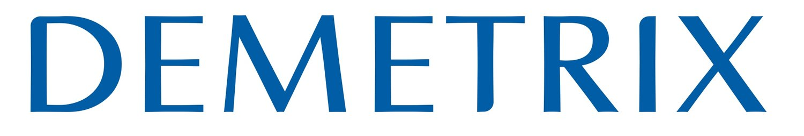
Darren Platt President, Demetrix
F# for Python Programmers in Biotech
Notes:
Faster intros. Don & Guest & Slide (20 seconds max each)

Slide 33
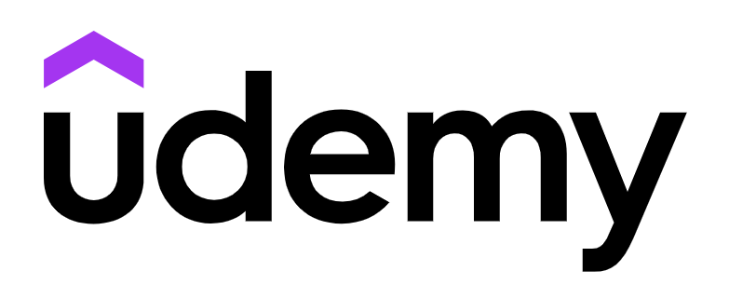
Kit Eason Principal Developer, Perpetuum Ltd. & Udemy Author
Learning and Teaching F#
Notes:
Faster intros. Don & Guest & Slide (20 seconds max each)
Ambika – student, functional programming
Darren – bioinformatics, ex-Python developer
Kit – educator, teacher on “F# from the Ground Up”
Kevin – graduate student, bioinformatics, FSharp.Stats and FsLab
Faisal – researcher, deep learning
Ambika – we talk about how you first got interested in F#, and why you like it as one of the languages you’ve learned, and which of the themes attracted you (e.g. if functional programming – then robustness and expressivity)
Darren – we talk about the advantages of F# over Python from your work experience
Kit – we talk about succinctness from an educators point-of-view – does it make it easier to teach the language?
Kevin – we talk about why your group are using F#, and what advantages you see, and look forward to your talk later
Faisal – we talk about your recent work on Graph Convolutional Neural Networks and the remarkable results where F# code was same size and 10x as performant on data-loading.
Kit, you’re one of the most experienced teachers of F#. Tell us about the online course you’ve made.
How did you get involved in F#?
What have you learned about teaching programming?
TBD

Slide 34
Learning Resources
dot.net/fsharp
docs.microsoft.com/learn/modules/fsharp-first-steps
udemy.com/course/fsharp-from-the-ground-up

Slide 35
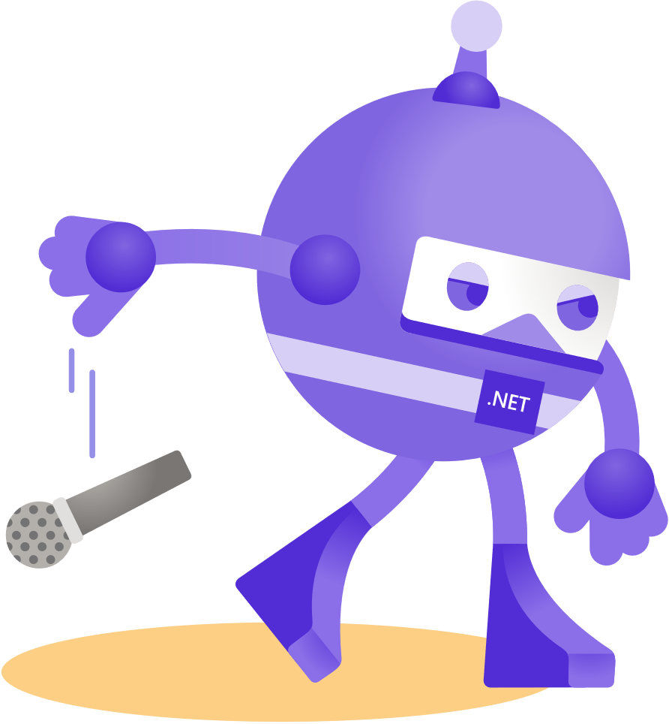
Thanks for joining!
Ask your questions live on Twitter #dotNETConf

